Slide 1


Marwadi University Faculty of Computer Applications MCA Sem- II
Basics of Python
(05MC0202)
Unit – 4
Data Science,
Drawing Graphs and Regular Expression

Slide 2
Understanding and Installing Pandas
Pandas is a Python library used for working with data sets.
It has functions for analyzing, cleaning, exploring, and manipulating data.
The name "Pandas" has a reference to both "Panel Data", and "Python Data Analysis" and was created by Wes McKinney in 2008.

Slide 3
Need for Pandas
Pandas allows us to analyze big data and make conclusions based on statistical theories.
Pandas can clean messy data sets, and make them readable and relevant.
Relevant data is very important in data science.
Data Science: is a branch of computer science where we study how to store, use and analyze data for deriving information from it.

Slide 4
What Pandas can do?
Pandas gives you answers about the data. Like:
Is there a correlation between two or more columns?
What is average value?
Max value?
Min value?
Pandas are also able to delete rows that are not relevant, or contains wrong values, like empty or NULL values. This is called cleaning the data.

Slide 5
Installation
To install Pandas library in your machine you need to give following command :
pip install pandas
Once the installation gets over you can import Pandas library in your idle by using following command :
import pandas

Slide 6
Installation
To check installation you can use following example :
import pandas
mydataset = {
'cars': ["BMW", "Volvo", "Ford"],
'passings': [3, 7, 2]
}
myvar = pandas.DataFrame(mydataset)
print(myvar)
O/p.
cars passings
0 BMW 3
1 Volvo 7
2 Ford 2

Slide 7
Pandas as pd
Pandas is usually imported under the pd alias.
alias: In Python alias are an alternate name for referring to the same thing.
Create an alias with the as keyword while importing:
import pandas as pd
import pandas as pd mydataset = { 'cars': ["BMW", "Volvo", "Ford"], 'passings': [3, 7, 2] } myvar = pd.DataFrame(mydataset) print(myvar)

Slide 8
Checking Pandas Version
The version string is stored under __version__ attribute.
import pandas as pd print(pd.__version__)

Slide 9
Data Frames
A Pandas DataFrame is a 2 dimensional data structure, like a 2 dimensional array, or a table with rows and columns.

Slide 10
Simple Data Frame Example
calories duration 0 420 50 1 380 40 2 390 45
import pandas as pd
data = {
"calories": [420, 380, 390],
"duration": [50, 40, 45]
}
#load data into a DataFrame object:
df = pd.DataFrame(data)
print(df)
O/p.
calories duration
0 420 50
1 380 40
2 390 45

Slide 11
Data Frame in detail
calories duration 0 420 50 1 380 40 2 390 45
A pandas DataFrame can be created using various inputs like −
● Lists
● Dict
● Dict of list
● Another DataFrame, files like excel, csv etc

Slide 12
Create Empty Data Frame
calories duration 0 420 50 1 380 40 2 390 45
A basic DataFrame, which can be created is an Empty Dataframe.
Example
#import the pandas library and aliasing as pd
import pandas as pd
df = pd.DataFrame()
print (df)
Output
Empty DataFrame
Columns: []
Index: []

Slide 13
Create Dataframe from List
calories duration 0 420 50 1 380 40 2 390 45
The DataFrame can be created using a single list or a list of lists.
Example
import pandas as pd
data = [1,2,3,4,5]
df = pd.DataFrame(data)
print (df)
Output
0
0 1
1 2
2 3
3 4
4 5

Slide 14
Create Dataframe from List
calories duration 0 420 50 1 380 40 2 390 45
import pandas as pd
data = [['Alex',10],['Bob',12],['Clarke',13]]
df = pd.DataFrame(data,columns=['Name','Age'])
print (df)
Its output is as follows −
Name Age
0 Alex 10
1 Bob 12
2 Clarke 13

Slide 15
Create Dataframe from Dict of ndarrays
calories duration 0 420 50 1 380 40 2 390 45
All the ndarrays must be of same length. If index is passed, then the length of the index should equal to the length of the arrays.
If no index is passed, then by default, index will be range(n), where n is the array length.

Slide 16
Create Dataframe from Dict of ndarrays
calories duration 0 420 50 1 380 40 2 390 45
import pandas as pd
data = {'Name':['Tom', 'Jack', 'Steve', 'Ricky'],'Age':[28,34,29,42]}
df = pd.DataFrame(data)
print (df)
Its output is as follows −
Age Name
0 28 Tom
1 34 Jack
2 29 Steve
3 42 Ricky

Slide 17
Create Dataframe from Dict of ndarrays
calories duration 0 420 50 1 380 40 2 390 45
Let us now create an indexed DataFrame using arrays.
import pandas as pd
data = {'Name':['Tom', 'Jack', 'Steve', 'Ricky'],'Age':[28,34,29,42]}
df = pd.DataFrame(data, index=['rank1','rank2','rank3','rank4'])
print (df)
Its output is as follows − Note − Observe, the index parameter assigns an index to each row.
Age Name
rank1 28 Tom
rank2 34 Jack
rank3 29 Steve
rank4 42 Ricky

Slide 18
Create Dataframe from List of Dicts
calories duration 0 420 50 1 380 40 2 390 45
List of Dictionaries can be passed as input data to create a DataFrame. The dictionary keys are by default taken as column names. Note − Observe, NaN (Not a Number) is appended in missing areas.
import pandas as pd
data = [{'a': 1, 'b': 2},{'a': 5, 'b': 10, 'c': 20}]
df = pd.DataFrame(data)
print (df)
Its output is as follows −
a b c
0 1 2 NaN
1 5 10 20.0

Slide 19
Create Dataframe from List of Dicts
calories duration 0 420 50 1 380 40 2 390 45
The following example shows how to create a DataFrame by passing a list of dictionaries and the row indices.
import pandas as pd
data = [{'a': 1, 'b': 2},{'a': 5, 'b': 10, 'c': 20}]
df = pd.DataFrame(data, index=['first', 'second'])
print (df)
Its output is as follows −
a b c
first 1 2 NaN
second 5 10 20.0

Slide 20
Create Dataframe from List of Dicts
calories duration 0 420 50 1 380 40 2 390 45
The following example shows how to create a DataFrame with a list of dictionaries, row indices, and column indices.
import pandas as pd
data = [{'a': 1, 'b': 2},{'a': 5, 'b': 10, 'c': 20}]
#With two column indices, values same as dictionary keys
df1 = pd.DataFrame(data, index=['first', 'second'], columns=['a', 'b'])
#With two column indices with one index with other name
df2 = pd.DataFrame(data, index=['first', 'second'], columns=['a', 'b1'])
print (df1)
print (df2)

Slide 21
Create Dataframe from List of Dicts
calories duration 0 420 50 1 380 40 2 390 45
#df1 output
a b
first 1 2
second 5 10
#df2 output
a b1
first 1 NaN
second 5 NaN
Note − Observe, df2 DataFrame is created with a column index other than the dictionary key; thus, appended the NaN’s in place. Whereas, df1 is created with column indices same as dictionary keys, so NaN’s appended.

Slide 22
Create Dataframe using excel files
calories duration 0 420 50 1 380 40 2 390 45
Let’s see how to read excel files to Pandas dataframe objects using Pandas.
Note : install openpyxl required
Go to run→cmd—> pip install openpyxl
Go to idle —-> import openpyxl

Slide 23
Create Dataframe using excel files
calories duration 0 420 50 1 380 40 2 390 45
# import pandas lib as pd
import pandas as pd
# read by default 1st sheet of an excel file
dataframe1=pd.read_excel('d:\\test.xlsx')
print(dataframe1)
Output :
sr name
0 1 a
1 2 b
2 3 c

Slide 24
Create Dataframe using excel files
calories duration 0 420 50 1 380 40 2 390 45
#import pandas lib as pd
import pandas as pd
#read 2nd sheet of an excel file
dataframe2 = pd.read_excel(‘d:\\test.xlsx', sheet_name = ‘Sheet2’)
print(dataframe2)

Slide 25
Create Dataframe using list of tuples
calories duration 0 420 50 1 380 40 2 390 45
We can create a DataFrame from a list of simple tuples, and can even choose the specific elements of the tuples we want to use

Slide 26
Create Dataframe using list of tuples
calories duration 0 420 50 1 380 40 2 390 45
# import pandas to use pandas DataFrame
import pandas as pd
# data in the form of list of tuples
data = [('Peter', 18, 7),
('Riff', 15, 6),
('John', 17, 8),
('Michel', 18, 7),
('Sheli', 17, 5) ]
# create DataFrame using data
df = pd.DataFrame(data, columns =['Name', 'Age', 'Score'])
print(df)

Slide 27
Create Dataframe using csv file
calories duration 0 420 50 1 380 40 2 390 45
CSV files are the “comma-separated values”, these values are separated by commas, this file can be view like as excel file
read_csv() method is an important pandas function to read csv files and do operations on it.

Slide 28
Create Dataframe using csv file
calories duration 0 420 50 1 380 40 2 390 45
# creating a data frame using CSV files
# import pandas module
import pandas as pd
# creating a data frame
df = pd.read_csv(“d:\\test1.csv")
print(df)

Slide 29
Use of Head() function
calories duration 0 420 50 1 380 40 2 390 45
The head() method returns a specified number of rows, string from the top.
The head() method returns the first 5 rows if a number is not specified.
import pandas as pd
df = pd.read_csv('data.csv')
print(df.head())

Slide 30
Use of Tail() function
calories duration 0 420 50 1 380 40 2 390 45
The tail() method returns a specified number of last rows.
The tail() method returns the last 5 rows if a number is not specified.
import pandas as pd
df = pd.read_csv('data.csv')
print(df.tail())

Slide 31
Use of Shape property
calories duration 0 420 50 1 380 40 2 390 45
The shape property returns a tuple containing the shape of the DataFrame.
The shape is the number of rows and columns of the DataFrame
import pandas as pd
df = pd.read_csv('data.csv')
print(df.shape)

Slide 32
Use of Columns property
calories duration 0 420 50 1 380 40 2 390 45
The columns property returns the label of each column in the DataFrame.
import pandas as pd
df = pd.read_csv('data.csv')
print(df.columns)

Slide 33
Use of Size property
calories duration 0 420 50 1 380 40 2 390 45
The size property returns the number of elements in the DataFrame.
The number of elements is the number of rows * the number of columns.
If in our example the DataFrame has 169 rows and 4 columns: 169 * 4 = 676
import pandas as pd
df = pd.read_csv('data.csv')
print(df.size)

Slide 34
Use of Dtypes property
calories duration 0 420 50 1 380 40 2 390 45
The dtypes property returns data type of each column in the DataFrame.
import pandas as pd
df = pd.read_csv('data.csv')
print(df.dtypes)

Slide 35
Use of describe() method
calories duration 0 420 50 1 380 40 2 390 45
The describe() method returns description of the data in the DataFrame.
If the DataFrame contains numerical data, the description contains these information for each column:
count - The number of not-empty values.
mean - The average (mean) value.
std - The standard deviation.
min - the minimum value.
25% - The 25% percentile*.
50% - The 50% percentile*.
75% - The 75% percentile*.
max - the maximum value.
*Percentile meaning: how many of the values are less than the given percentile.

Slide 36
Use of describe() method
calories duration 0 420 50 1 380 40 2 390 45
import pandas as pd
data = [[10, 18, 11], [13, 15, 8], [9, 20, 3]]
df = pd.DataFrame(data)
print(df.describe())

Slide 37
Use of max() method
calories duration 0 420 50 1 380 40 2 390 45
The max() method returns a Series with the maximum value of each column.
By specifying the column axis (axis='columns'), the max() method searches column-wise and returns the maximum value for each row.
import pandas as pd
data = [[10, 18, 11], [13, 15, 8], [9, 20, 3]]
df = pd.DataFrame(data)
print(df.max())

Slide 38
Use of min() method
calories duration 0 420 50 1 380 40 2 390 45
The min() method returns a Series with the minimum value of each column.
By specifying the column axis (axis='columns'), the max() method searches column-wise and returns the minimum value for each row.
import pandas as pd
data = [[10, 18, 11], [13, 15, 8], [9, 20, 3]]
df = pd.DataFrame(data)
print(df.min())

Slide 39
Other functions
calories duration 0 420 50 1 380 40 2 390 45
For other functions related to Pandas you can refer to the following link :
https://www.javatpoint.com/python-pandas-dataframe

Slide 40
Indexing and Sorting
calories duration 0 420 50 1 380 40 2 390 45
Sorting and Indexing are two most important functions that we perform on any dataset.
These are very basic and useful because every dataset we need to have Sorting and indexing to do some analysis tasks on the data.

Slide 41
The index property
calories duration 0 420 50 1 380 40 2 390 45
The index property returns the index information of the DataFrame.
The index information contains the labels of the rows. If the rows has NOT named indexes, the index property returns a RangeIndex object with the start, stop, and step values.
import pandas as pd
df = pd.read_csv('data.csv')
print(df.index)

Slide 42
The set_index() method
calories duration 0 420 50 1 380 40 2 390 45
The set_index() method allows one or more column values become the row index.
import pandas as pd
data = {
"name": ["Sally", "Mary", "John", "Monica"],
"age": [50, 40, 30, 40],
"qualified": [True, False, False, False]
}
df = pd.DataFrame(data)
print(df)
newdf = df.set_index('name')
print(newdf)

Slide 43
The loc property
calories duration 0 420 50 1 380 40 2 390 45
The loc property gets, or sets, the value(s) of the specified labels.
Specify both row and column with a label.
To access more than one row, use double brackets and specify the labels, separated by commas:
df.loc[["Sally", "John"]]
Specify columns by including their labels in another list:
df.loc[["Sally", "John"], ["age", "qualified"]]
You can also specify a slice of the DataFrame with from and to labels, separated by a colon:
df.loc["Sally": "John"]
Note : When slicing, both from and to are included in the result.

Slide 44
The loc property
calories duration 0 420 50 1 380 40 2 390 45
import pandas as pd
data = [[50, True], [40, False], [30, False]]
label_rows = ["Sally", "Mary", "John"]
label_cols = ["age", "qualified"]
df = pd.DataFrame(data, label_rows, label_cols)
print(df.loc["Mary", "age"])

Slide 45
The reset_index() method
calories duration 0 420 50 1 380 40 2 390 45
The reset_index() method allows you reset the index back to the default 0, 1, 2 etc indexes.
By default this method will keep the "old" idexes in a column named "index", to avoid this, use the drop parameter.

Slide 46
The reset_index() method
calories duration 0 420 50 1 380 40 2 390 45
import pandas as pd
data = {
"name": ["Sally", "Mary", "John"],
"age": [50, 40, 30],
"qualified": [True, False, False]
}
idx = ["X", "Y", "Z"]
df = pd.DataFrame(data, index=idx)
print(df)
newdf = df.reset_index()
print(newdf)

Slide 47
The sort_values() method
calories duration 0 420 50 1 380 40 2 390 45
The sort_values() method sorts the DataFrame by the specified label.
import pandas as pd
data = {
"age": [50, 40, 30, 40, 20, 10, 30],
"qualified": [True, False, False, False, False, True, True]
}
df = pd.DataFrame(data)
print(df)
newdf = df.sort_values(by='age')
print(newdf)

Slide 48
The dropna() method
calories duration 0 420 50 1 380 40 2 390 45
The dropna() method removes the rows that contains NULL values.
The dropna() method returns a new DataFrame object unless the inplace parameter is set to True, in that case the dropna() method does the removing in the original DataFrame instead.
import pandas as pd
df = pd.read_csv('data.csv')
newdf = df.dropna()
print(newdf)

Slide 49
The fillna() method
calories duration 0 420 50 1 380 40 2 390 45
The fillna() method replaces the NULL values with a specified value.
The fillna() method returns a new DataFrame object unless the inplace parameter is set to True, in that case the fillna() method does the replacing in the original DataFrame instead.
import pandas as pd
df = pd.read_csv('data.csv')
newdf = df.fillna(222222)

Slide 50
Different types of Basic Graphs
calories duration 0 420 50 1 380 40 2 390 45
There are various types of graphs available in python specifically for Data Analysis.
It includes :
Line Graph
Bar Graph
Histogram Graph
Pie Graph

Slide 51
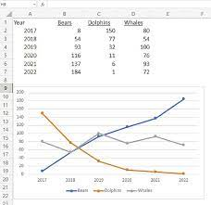
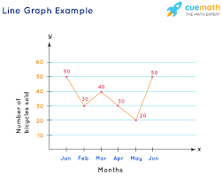
Line Graph
calories duration 0 420 50 1 380 40 2 390 45

Slide 52
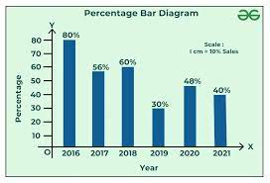
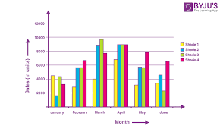
Bar Graph
calories duration 0 420 50 1 380 40 2 390 45

Slide 53
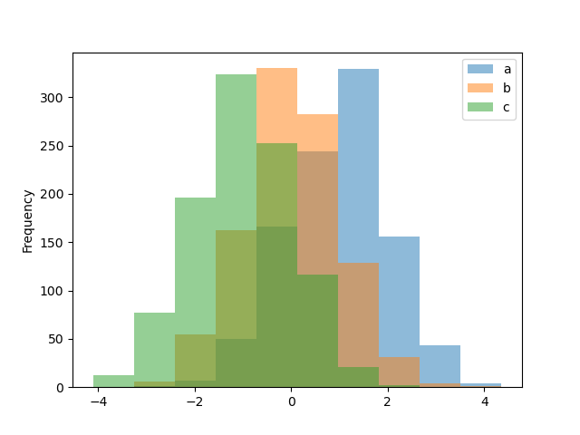
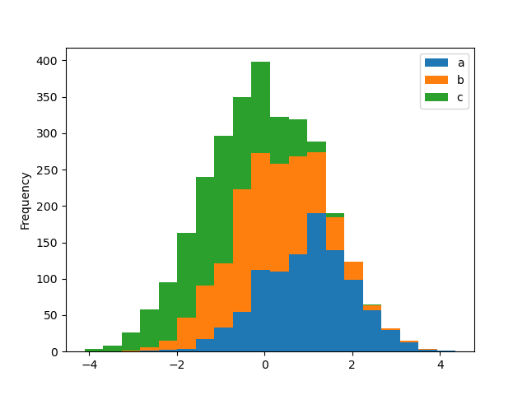
Histogram Graph
calories duration 0 420 50 1 380 40 2 390 45

Slide 54
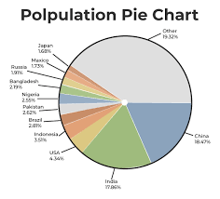
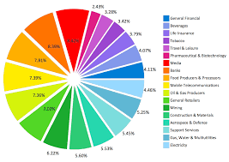
Pie Graph
calories duration 0 420 50 1 380 40 2 390 45

Slide 55
Line Graph
calories duration 0 420 50 1 380 40 2 390 45
Matplotlib is a data visualization library in Python.
The pyplot, a sublibrary of matplotlib, is a collection of functions that helps in creating a variety of charts.
Line charts are used to represent the relation between two data X and Y on a different axis.
Here we will see some of the examples of a line chart in Python :
First import Matplotlib.pyplot library for plotting functions.
Also, import the Numpy library as per requirement.
Then define data values x and y.
pip install matplotlib

Slide 56
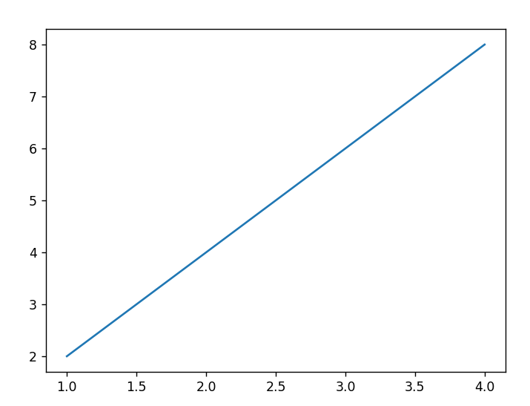
Line Graph
calories duration 0 420 50 1 380 40 2 390 45
import matplotlib.pyplot as plt
import numpy as np
# define data values
x = [1, 2, 3, 4] # X-axis points
y = [2, 4, 6, 8] # Y-axis points
plt.plot(x, y) # Plot the chart
plt.show()

Slide 57
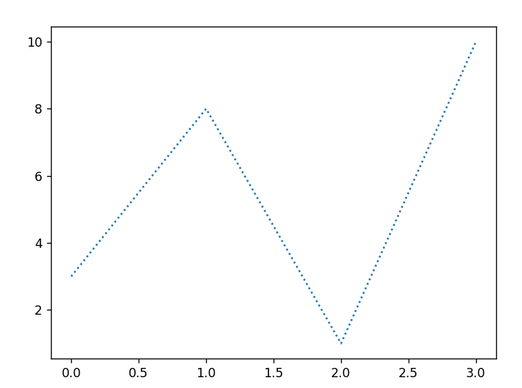
Line Graph
calories duration 0 420 50 1 380 40 2 390 45
import matplotlib.pyplot as plt
import numpy as np
ypoints = np.array([3, 8, 1, 10])
plt.plot(ypoints, linestyle = 'dotted')
plt.show()

Slide 58
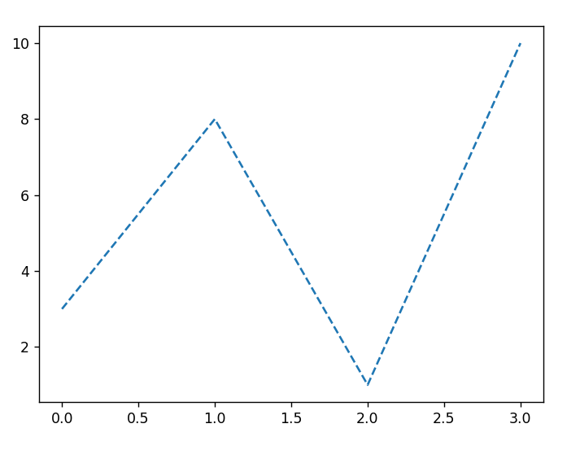
Line Graph
calories duration 0 420 50 1 380 40 2 390 45
import matplotlib.pyplot as plt
import numpy as np
ypoints = np.array([3, 8, 1, 10])
plt.plot(ypoints, linestyle = 'dashed')
plt.show()

Slide 59
Line Graph
calories duration 0 420 50 1 380 40 2 390 45
You can use short syntax for some keywords as given in below examples :
linestyle can be written as ls.
dotted can be written as :.
dashed can be written as --.
dashdot can be written as -.

Slide 60
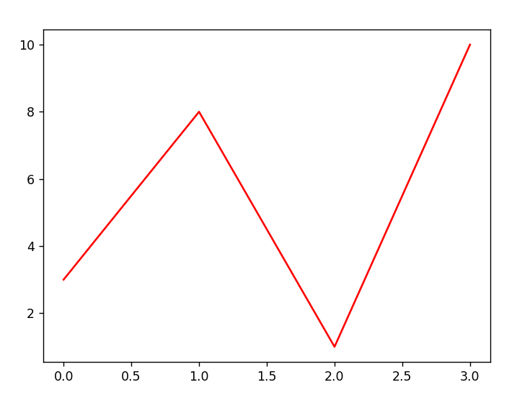
Line Graph
calories duration 0 420 50 1 380 40 2 390 45
Line Color :
You can use the keyword argument color or the shorter c to set the color of the line:
import matplotlib.pyplot as plt
import numpy as np
ypoints = np.array([3, 8, 1, 10])
plt.plot(ypoints, color = 'r')
plt.show()

Slide 61
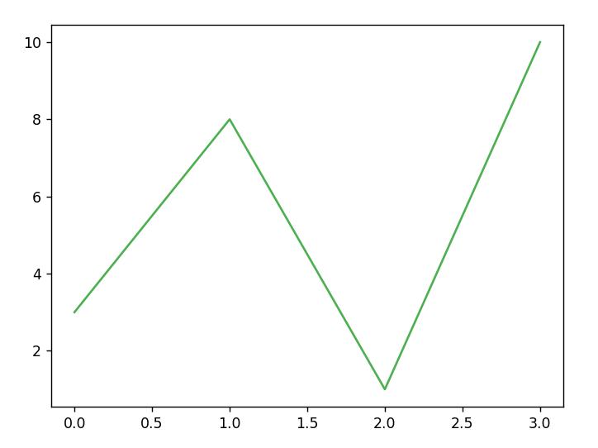
Line Graph
calories duration 0 420 50 1 380 40 2 390 45
You can also use Hexadecimal color values:
import matplotlib.pyplot as plt
import numpy as np
ypoints = np.array([3, 8, 1, 10])
plt.plot(ypoints, color = '#4CAF50')
plt.show()

Slide 62
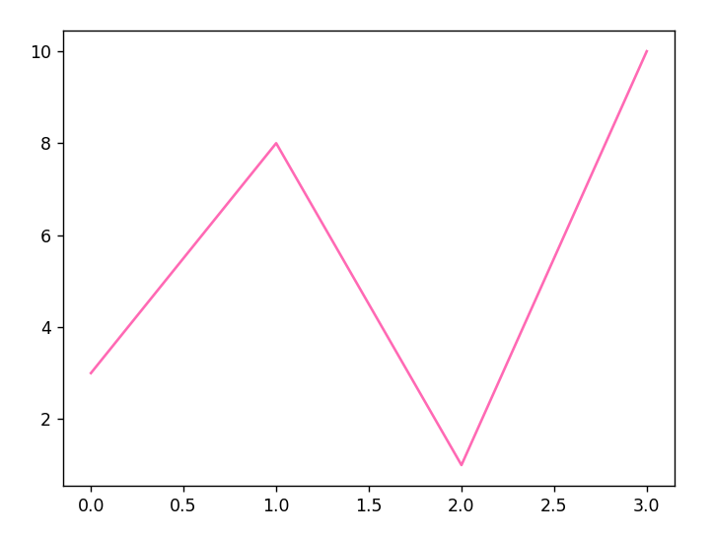
Line Graph
calories duration 0 420 50 1 380 40 2 390 45
You can also use any supported color values:
https://www.w3schools.com/colors/colors_names.asp
import matplotlib.pyplot as plt
import numpy as np
ypoints = np.array([3, 8, 1, 10])
plt.plot(ypoints, color = ‘hotpink')
plt.show()

Slide 63
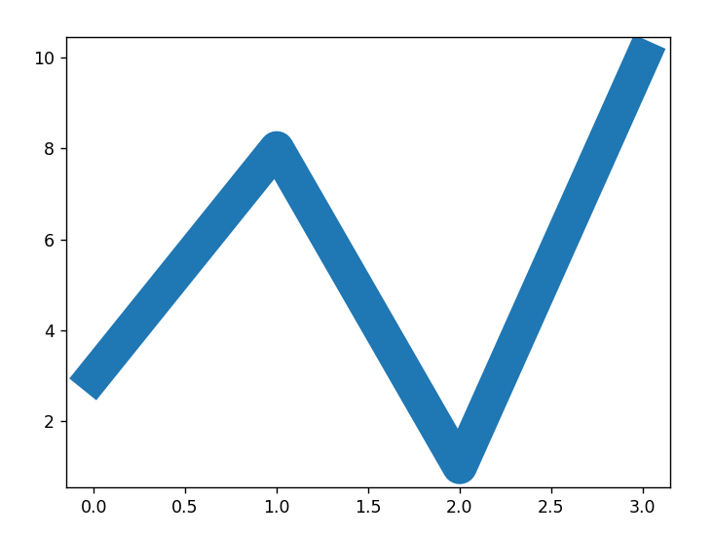
Line Graph
calories duration 0 420 50 1 380 40 2 390 45
You can use the keyword argument linewidth or the shorter lw to change the width of the line.
The value is a floating number, in points:
import matplotlib.pyplot as plt
import numpy as np
ypoints = np.array([3, 8, 1, 10])
plt.plot(ypoints, linewidth = '20.5')
plt.show()

Slide 64
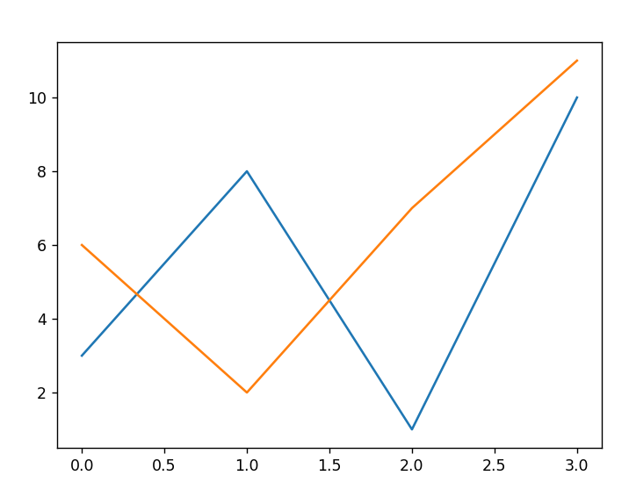
Line Graph
calories duration 0 420 50 1 380 40 2 390 45
Multiple line graph is also possible
You can plot as many lines as you like by simply adding more plt.plot() functions:
import matplotlib.pyplot as plt
import numpy as np
y1 = np.array([3, 8, 1, 10])
y2 = np.array([6, 2, 7, 11])
plt.plot(y1)
plt.plot(y2)
plt.show()

Slide 65
Line Graph
calories duration 0 420 50 1 380 40 2 390 45
You can also plot many lines by adding the points for the x- and y-axis for each line in the same plt.plot() function.
(In the examples above we only specified the points on the y-axis, meaning that the points on the x-axis got the the default values (0, 1, 2, 3).)
The x- and y- values come in pairs:

Slide 66
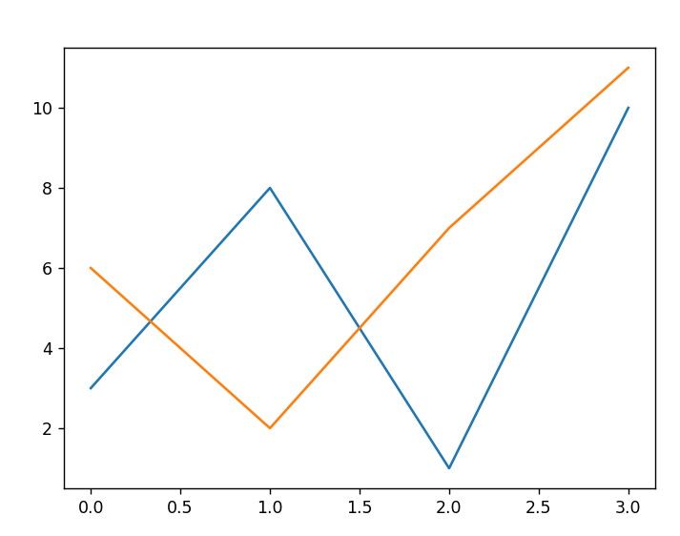
Line Graph
calories duration 0 420 50 1 380 40 2 390 45
import matplotlib.pyplot as plt
import numpy as np
x1 = np.array([0, 1, 2, 3])
y1 = np.array([3, 8, 1, 10])
x2 = np.array([0, 1, 2, 3])
y2 = np.array([6, 2, 7, 11])
plt.plot(x1, y1, x2, y2)
plt.show()

Slide 67
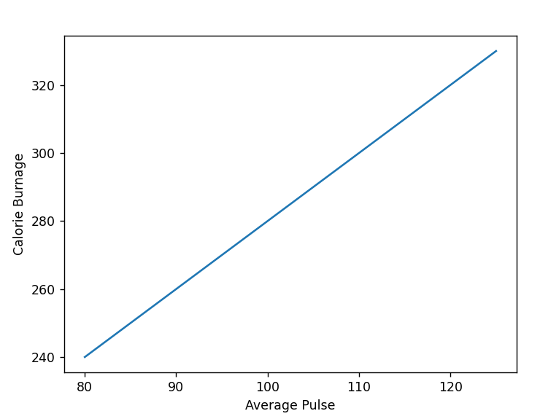
Add labels to graph
calories duration 0 420 50 1 380 40 2 390 45
import numpy as np
import matplotlib.pyplot as plt
x = np.array([80, 85, 90, 95, 100, 105, 110, 115, 120, 125])
y = np.array([240, 250, 260, 270, 280, 290, 300, 310, 320, 330])
plt.plot(x, y)
plt.xlabel("Average Pulse")
plt.ylabel("Calorie Burnage")
plt.show()

Slide 68
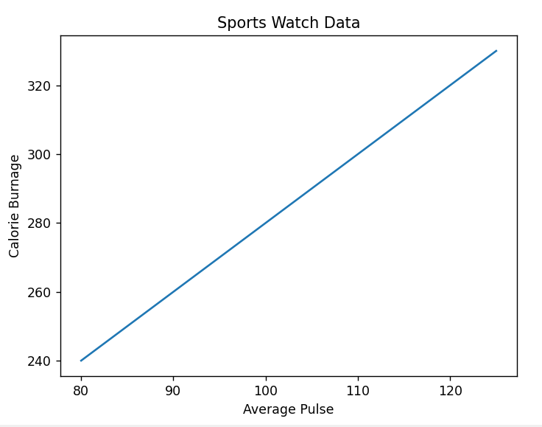
Chart Title to graph
calories duration 0 420 50 1 380 40 2 390 45
import numpy as np
import matplotlib.pyplot as plt
x = np.array([80, 85, 90, 95, 100, 105, 110, 115, 120, 125])
y = np.array([240, 250, 260, 270, 280, 290, 300, 310, 320, 330])
plt.plot(x, y)
plt.title("Sports Watch Data")
plt.xlabel("Average Pulse")
plt.ylabel("Calorie Burnage")
plt.show()

Slide 69
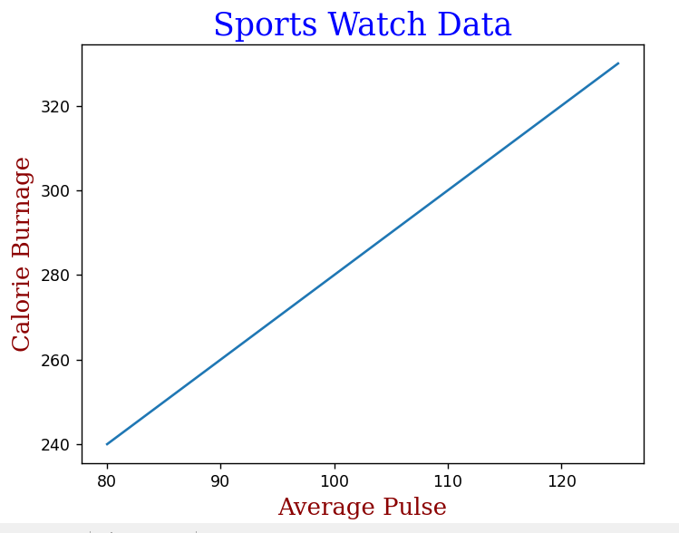
Fonts and colors to titles in graph
calories duration 0 420 50 1 380 40 2 390 45
import numpy as np
import matplotlib.pyplot as plt
x = np.array([80, 85, 90, 95, 100, 105, 110, 115, 120, 125])
y = np.array([240, 250, 260, 270, 280, 290, 300, 310, 320, 330])
font1 = {'family':'serif','color':'blue','size':20}
font2 = {'family':'serif','color':'darkred','size':15}
plt.title("Sports Watch Data", fontdict = font1)
plt.xlabel("Average Pulse", fontdict = font2)
plt.ylabel("Calorie Burnage", fontdict = font2)
plt.plot(x, y)
plt.show()

Slide 70
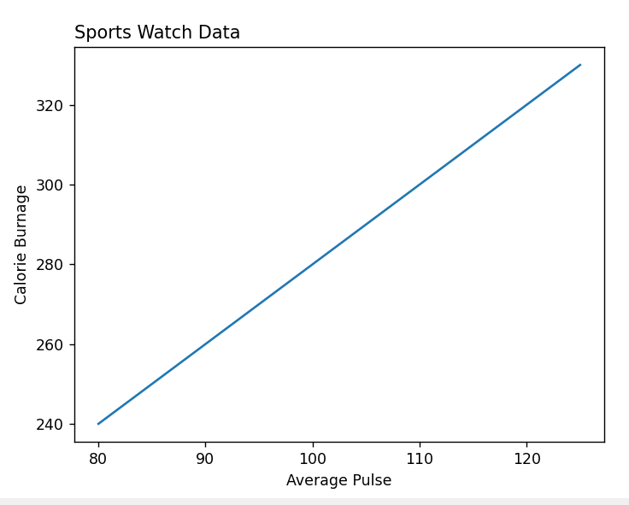
Position of title in Graph
calories duration 0 420 50 1 380 40 2 390 45
import numpy as np
import matplotlib.pyplot as plt
x = np.array([80, 85, 90, 95, 100, 105, 110, 115, 120, 125])
y = np.array([240, 250, 260, 270, 280, 290, 300, 310, 320, 330])
plt.title("Sports Watch Data", loc = 'left')
plt.xlabel("Average Pulse")
plt.ylabel("Calorie Burnage")
plt.plot(x, y)
plt.show()

Slide 71
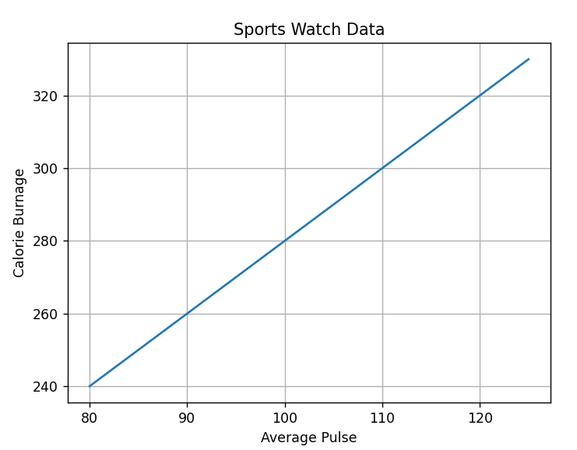
Gridlines in Graph
calories duration 0 420 50 1 380 40 2 390 45
import numpy as np
import matplotlib.pyplot as plt
x = np.array([80, 85, 90, 95, 100, 105, 110, 115, 120, 125])
y = np.array([240, 250, 260, 270, 280, 290, 300, 310, 320, 330])
plt.title("Sports Watch Data")
plt.xlabel("Average Pulse")
plt.ylabel("Calorie Burnage")
plt.plot(x, y)
plt.grid()
plt.show()

Slide 72
Gridlines in Graph
calories duration 0 420 50 1 380 40 2 390 45
plt.grid(axis = 'x‘)
plt.grid(axis = 'y')
plt.grid(color = 'green', linestyle = '--', linewidth = 0.5)

Slide 73
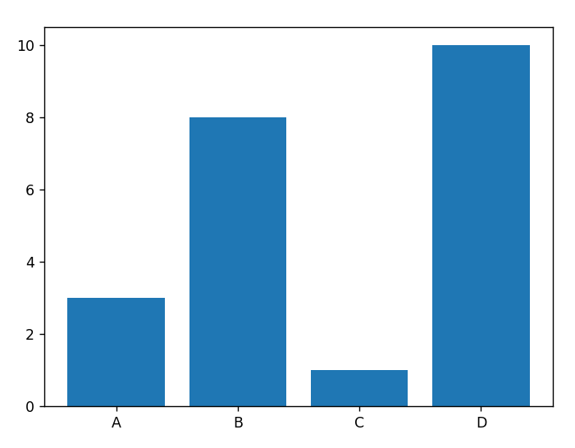
Bar Graph
calories duration 0 420 50 1 380 40 2 390 45
With Pyplot, you can use the bar() function to draw bar graphs:
import matplotlib.pyplot as plt
import numpy as np
x = np.array(["A", "B", "C", "D"])
y = np.array([3, 8, 1, 10])
plt.bar(x,y)
plt.show()

Slide 74
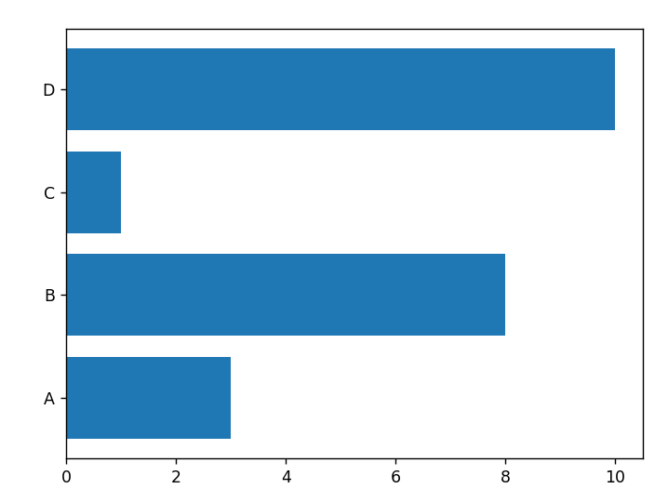
Bar Graph
calories duration 0 420 50 1 380 40 2 390 45
Horizontal Bars :
import matplotlib.pyplot as plt
import numpy as np
x = np.array(["A", "B", "C", "D"])
y = np.array([3, 8, 1, 10])
plt.barh(x, y)
plt.show()

Slide 75
Bar Graph
calories duration 0 420 50 1 380 40 2 390 45
plt.bar(x, y, color = "red")
plt.bar(x, y, width = 0.1)
plt.barh(x, y, height = 0.1)

Slide 76
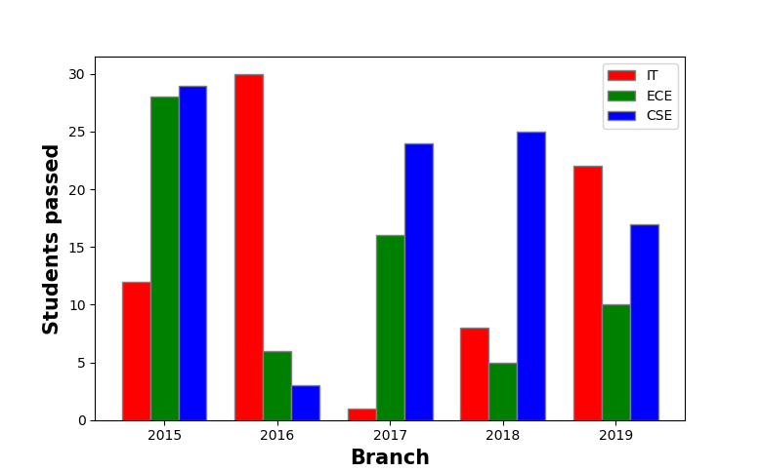
Bar Graph
calories duration 0 420 50 1 380 40 2 390 45
import numpy as np
import matplotlib.pyplot as plt
# set width of bar
barWidth = 0.25
fig = plt.subplots(figsize =(12, 8))
# set height of bar
IT = [12, 30, 1, 8, 22]
ECE = [28, 6, 16, 5, 10]
CSE = [29, 3, 24, 25, 17]
# Set position of bar on X axis
br1 = np.arange(len(IT))
br2 = [x + barWidth for x in br1]
br3 = [x + barWidth for x in br2]
# Make the plot
plt.bar(br1, IT, color ='r', width = barWidth,
edgecolor ='grey', label ='IT')
plt.bar(br2, ECE, color ='g', width = barWidth,
edgecolor ='grey', label ='ECE')
plt.bar(br3, CSE, color ='b', width = barWidth,
edgecolor ='grey', label ='CSE')
# Adding Xticks
plt.xlabel('Branch', fontweight ='bold', fontsize = 15)
plt.ylabel('Students passed', fontweight ='bold', fontsize = 15)
plt.xticks([r + barWidth for r in range(len(IT))],
['2015', '2016', '2017', '2018', '2019'])
plt.legend()
plt.show()

Slide 77
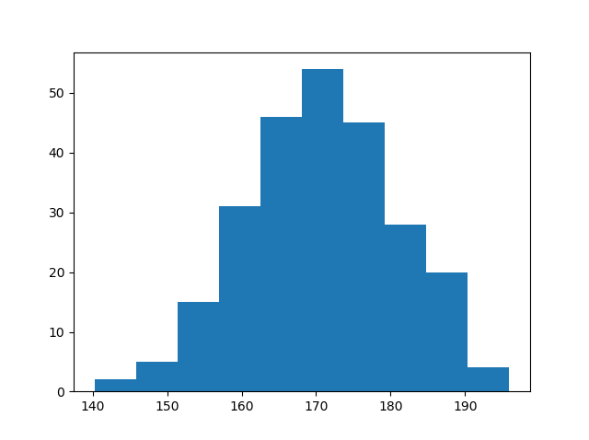
Histograms
calories duration 0 420 50 1 380 40 2 390 45
A histogram is a graph showing frequency distributions.
It is a graph showing the number of observations within each given interval.
Example: Say you ask for the height of 250 people, you might end up with a histogram like this:

Slide 78
Histograms
calories duration 0 420 50 1 380 40 2 390 45
You can read from the histogram that there are approximately:
2 people from 140 to 145cm
5 people from 145 to 150cm
15 people from 151 to 156cm
31 people from 157 to 162cm
46 people from 163 to 168cm
53 people from 168 to 173cm
45 people from 173 to 178cm
28 people from 179 to 184cm
21 people from 185 to 190cm
4 people from 190 to 195cm

Slide 79
Histograms
calories duration 0 420 50 1 380 40 2 390 45
In Matplotlib, we use the hist() function to create histograms.
The hist() function will use an array of numbers to create a histogram, the array is sent into the function as an argument.
For simplicity we use NumPy to randomly generate an array with 250 values, where the values will concentrate around 170, and the standard deviation is 10.

Slide 80
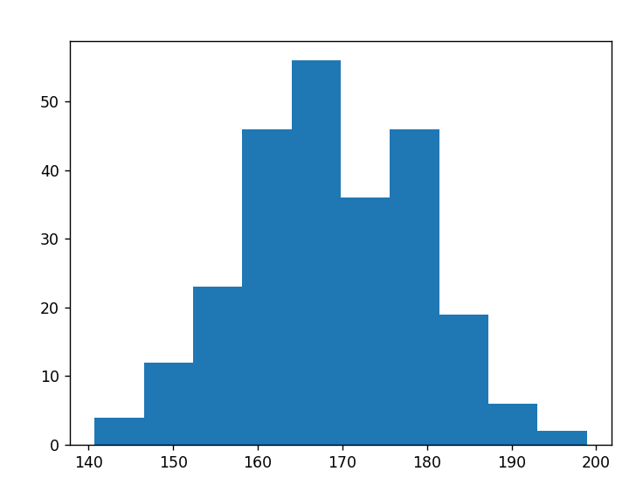
Histograms
calories duration 0 420 50 1 380 40 2 390 45
import numpy as np
x = np.random.normal(170, 10, 250)
print(x)
import matplotlib.pyplot as plt
import numpy as np
x = np.random.normal(170, 10, 250)
plt.hist(x)
plt.show()

Slide 81
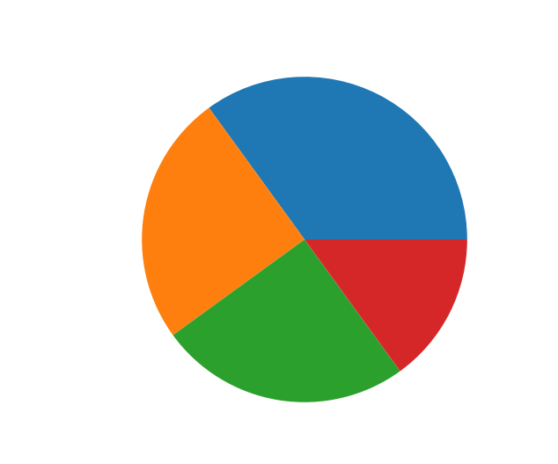
Pie Charts
calories duration 0 420 50 1 380 40 2 390 45
With Pyplot, you can use the pie() function to draw pie charts:
import matplotlib.pyplot as plt
import numpy as np
y = np.array([35, 25, 25, 15])
plt.pie(y)
plt.show()

Slide 82
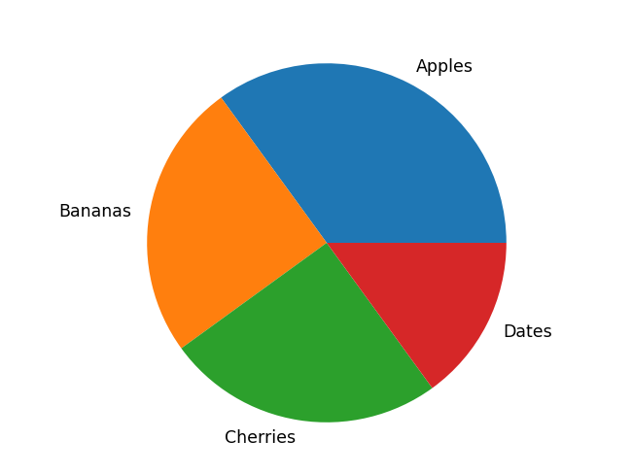
Pie Chart - Labels
calories duration 0 420 50 1 380 40 2 390 45
import matplotlib.pyplot as plt
import numpy as np
y = np.array([35, 25, 25, 15])
mylabels = ["Apples", "Bananas", "Cherries", "Dates"]
plt.pie(y, labels = mylabels)
plt.show()

Slide 83
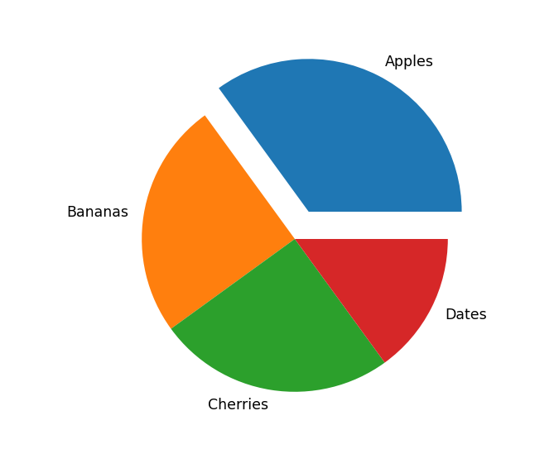
Pie Chart - explode
calories duration 0 420 50 1 380 40 2 390 45
import matplotlib.pyplot as plt
import numpy as np
y = np.array([35, 25, 25, 15])
mylabels = ["Apples", "Bananas", "Cherries", "Dates"]
myexplode = [0.2, 0, 0, 0]
plt.pie(y, labels = mylabels, explode = myexplode)
plt.show()

Slide 84
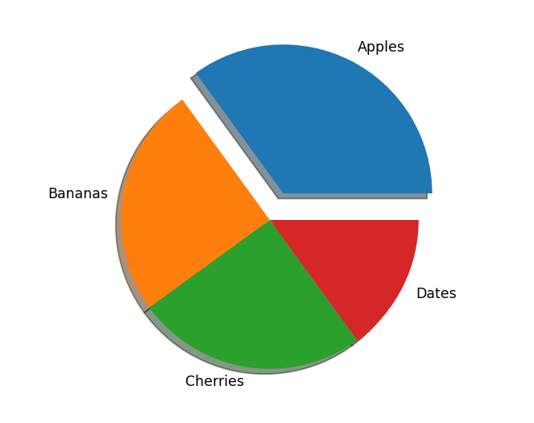
Pie Chart - shadow
calories duration 0 420 50 1 380 40 2 390 45
import matplotlib.pyplot as plt
import numpy as np
y = np.array([35, 25, 25, 15])
mylabels = ["Apples", "Bananas", "Cherries", "Dates"]
myexplode = [0.2, 0, 0, 0]
plt.pie(y, labels = mylabels, explode = myexplode, shadow = True)
plt.show()

Slide 85
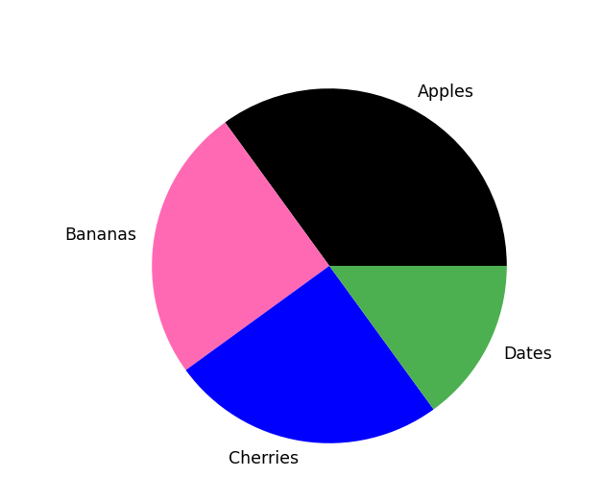
Pie Chart - colors
calories duration 0 420 50 1 380 40 2 390 45
import matplotlib.pyplot as plt
import numpy as np
y = np.array([35, 25, 25, 15])
mylabels = ["Apples", "Bananas", "Cherries", "Dates"]
mycolors = ["black", "hotpink", "b", "#4CAF50"]
plt.pie(y, labels = mylabels, colors = mycolors)
plt.show()

Slide 86
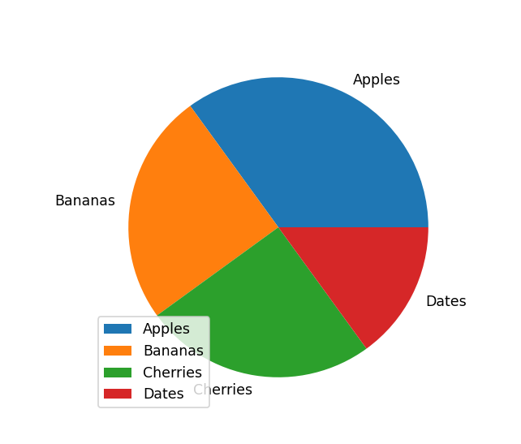
Pie Chart - legends
calories duration 0 420 50 1 380 40 2 390 45
import matplotlib.pyplot as plt
import numpy as np
y = np.array([35, 25, 25, 15])
mylabels = ["Apples", "Bananas", "Cherries", "Dates"]
plt.pie(y, labels = mylabels)
plt.legend()
plt.show()

Slide 87
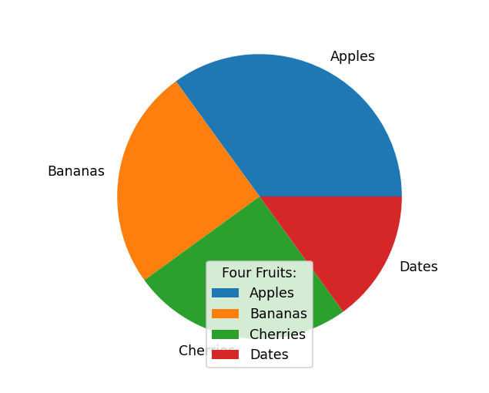
Pie Chart - legends
calories duration 0 420 50 1 380 40 2 390 45
import matplotlib.pyplot as plt
import numpy as np
y = np.array([35, 25, 25, 15])
mylabels = ["Apples", "Bananas", "Cherries", "Dates"]
plt.pie(y, labels = mylabels)
plt.legend(title = "Four Fruits:")
plt.show()

Slide 88
Regular Expression
calories duration 0 420 50 1 380 40 2 390 45
A RegEx, or Regular Expression, is a sequence of characters that forms a search pattern.
RegEx can be used to check if a string contains the specified search pattern.
Python has a built-in package called re, which can be used to work with Regular Expressions.
Import the re module
Import re

Slide 89
Regular Expression
calories duration 0 420 50 1 380 40 2 390 45
import re
#Check if the string starts with "The" and ends with "Spain":
txt = "The rain in Spain"
x = re.search("^The.*Spain$", txt)
if x:
print("YES! We have a match!")
else:
print("No match")

Slide 90
RegEx Functions
calories duration 0 420 50 1 380 40 2 390 45
The re module offers a set of functions that allows us to search a string for a match:
findall - Returns a list containing all matches
search - Returns a Match object if there is a match anywhere in the string
split - Returns a list where the string has been split at each match
Sub - Replaces one or many matches with a string
Remaining details on :
https://www.w3schools.com/python/python_regex.asp

Slide 91
Quantifies in RegEx
calories duration 0 420 50 1 380 40 2 390 45
Quantifier | Name | Meaning
* | Asterisk | Match its preceding element zero or more times.
+ | Plus | Match its preceding element one or more times.
? | Question Mark | Match its preceding element zero or one time.
{ n } | Curly Braces | Match its preceding element exactly n times.
{ n ,} | Curly Braces | Match its preceding element at least n times.
{ n , m } | Curly Braces | Match its preceding element from n to m times.

Slide 92
Thank You

